Slide 1





Presented by: Ethereal Envisions
ETHEREAL ENVISIONS
FUTURA FORGE
Unleash Your Imagination, Craft the Future

Slide 2

Overview
About Us
Our Mission
Home
Search
Explore
Contribute
Navigation
Profile
Our team
Thank you

Slide 3

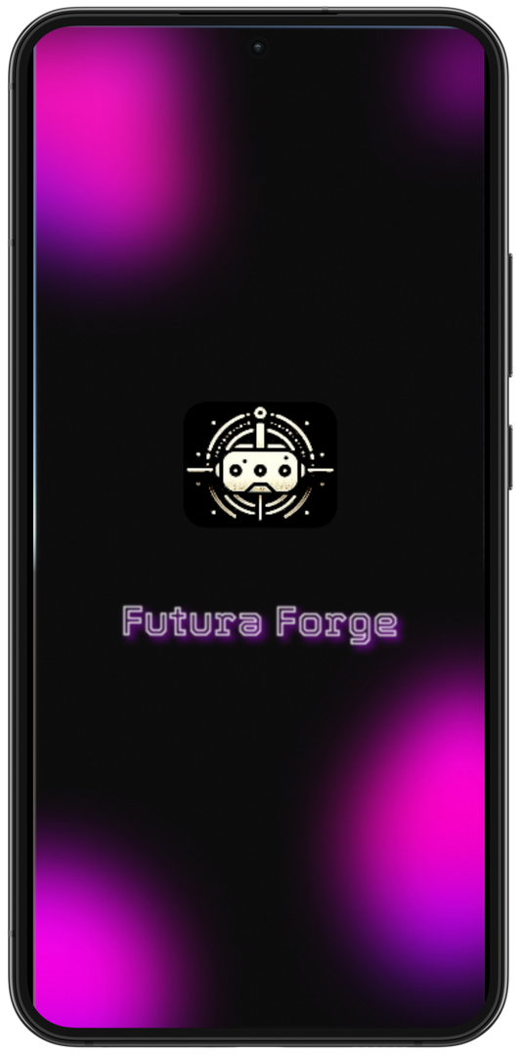
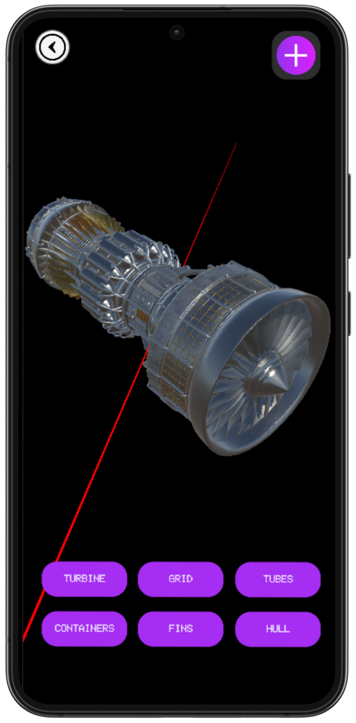
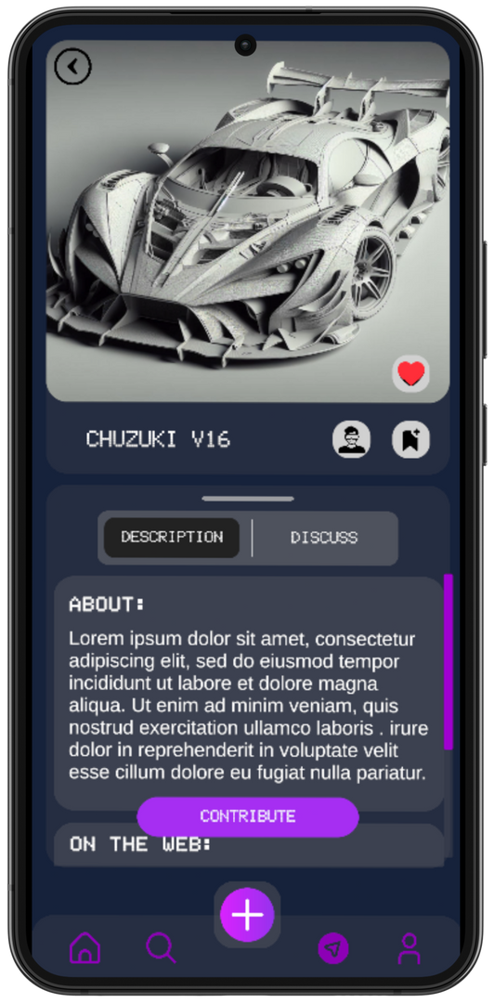
About Us

Slide 4
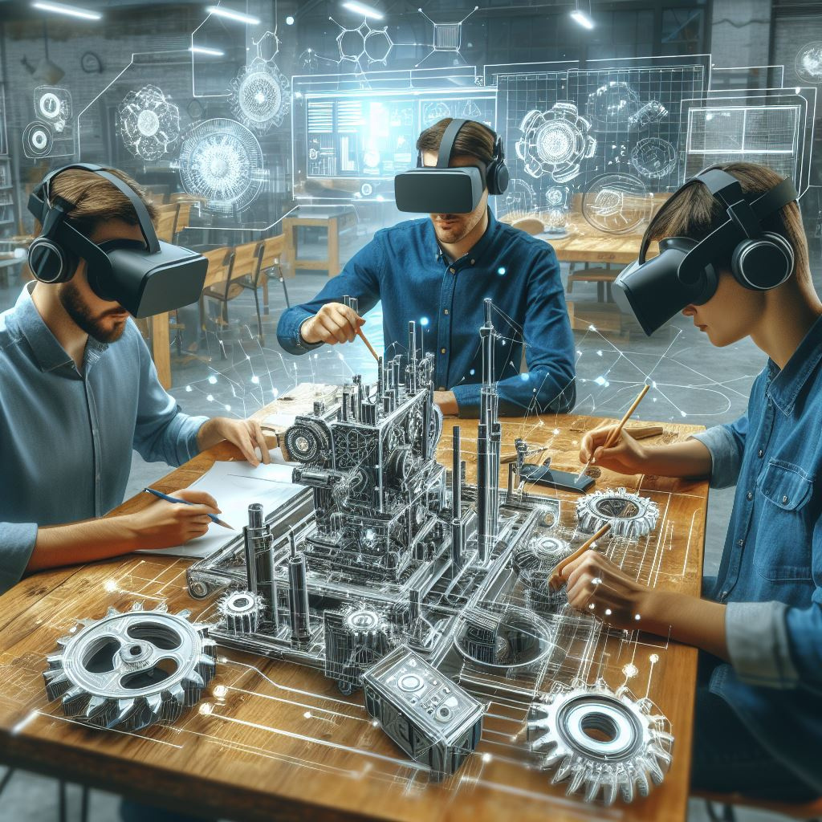
Revolutionizing Hardware Development Through Collaboration and Immersion
Drawing inspiration from the success of platforms like GitHub in the software domain, we present a groundbreaking concept - a collaborative hardware development platform. This platform aims to bring together hardware enthusiasts, engineers, and designers worldwide, fostering an environment of creativity, collaboration, and accelerated innovation with AR/VR technology to offer users an immersive project experience.

Slide 5
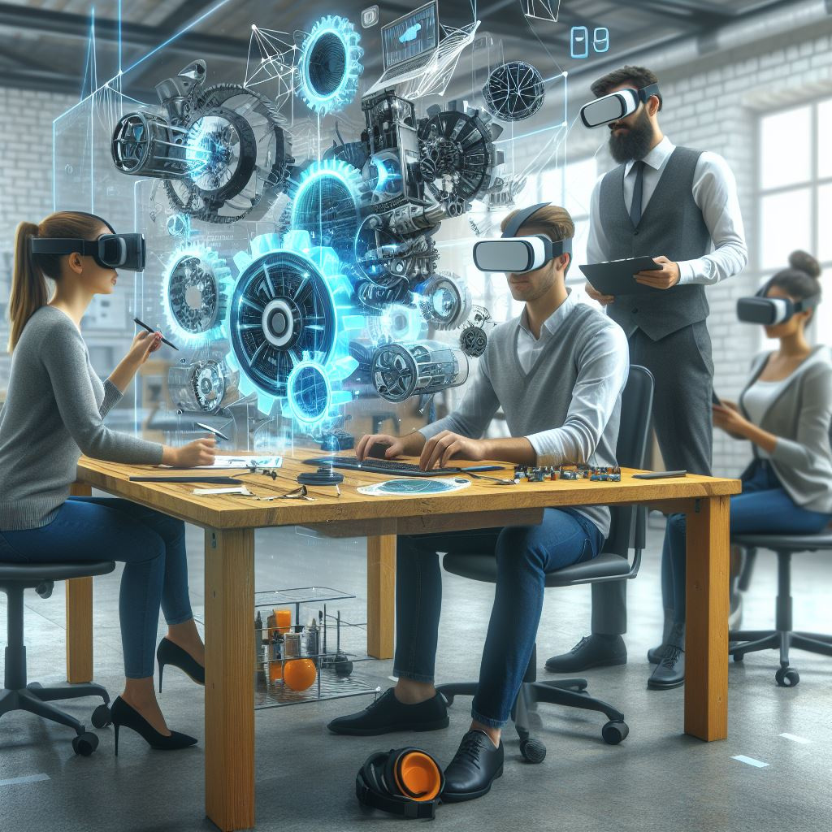


Goals
Objective 01
Disrupt Traditional Paradigms: Challenge the status quo of stagnant innovation in traditional hardware development methods by introducing a dynamic platform that democratizes access to open-source hardware projects, fosters collaboration, and empowers users to drive meaningful change and innovation in the industry.
Objective 02
Build a Thriving Community: Cultivate a vibrant and inclusive community of hardware enthusiasts, makers, and innovators who are passionate about collaborating, sharing knowledge, and pushing the boundaries of what's possible in open-source hardware development.

Slide 6
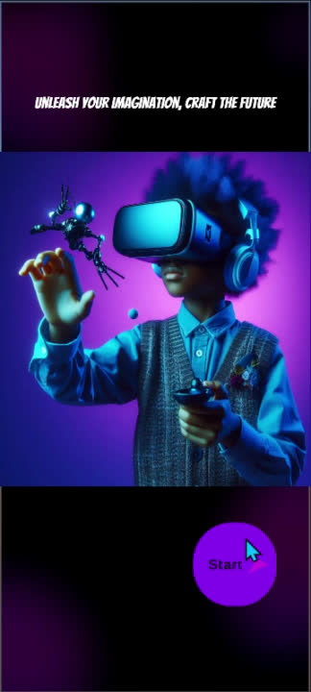
App Overview Video
Comprehensive Demonstration: Watch this brief video to see our AR/VR hardware collaboration app in action. The video provides a comprehensive overview of the app's core features and functionalities.

Slide 7


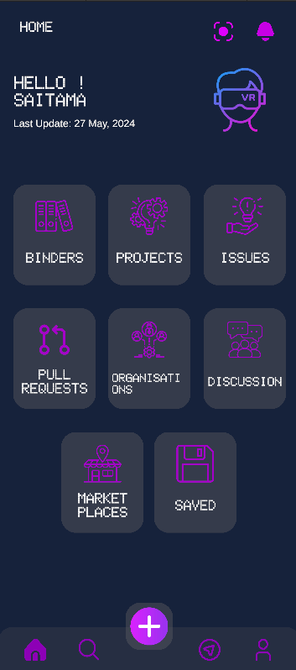
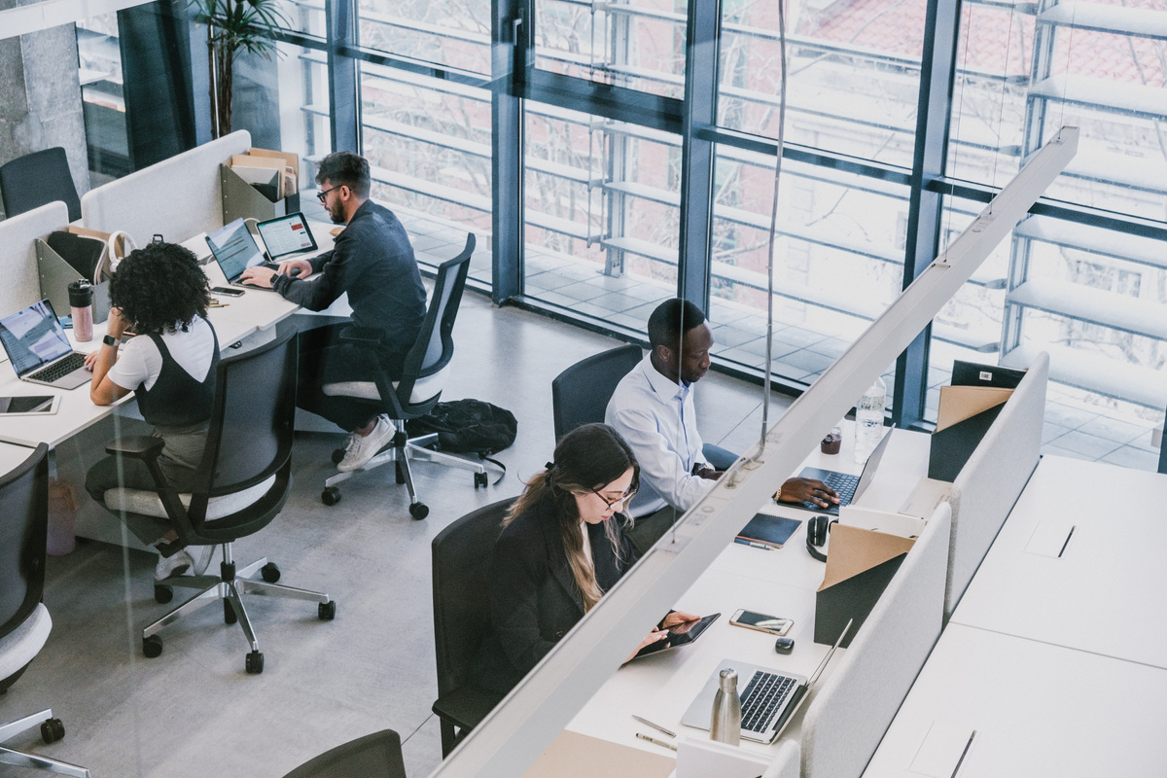
Home page
Smart object search
In our app's integrated camera in home UI, users can seamlessly explore their surroundings through the camera, effortlessly searching for 3D models and hardware components. With access to a curated database of open-source hardware products from leading companies, users can contribute to the advancement of collaborative hardware development in immersive AR/VR environments."
In our home UI, we've meticulously designed a familiar environment reminiscent of GitHub's interface, ensuring users feel right at home as they navigate through various options to seamlessly contribute to collaborative hardware projects.

Slide 8






Binders: this Organize and categorize projects, issues, and pull requests, providing users with a structured overview of their contributions and activities.
Projects: this Offers a visual project management tool, enabling users to plan, track, and prioritize tasks and milestones related to their hardware development endeavors.
Issues: this Facilitate efficient bug tracking and feature requests, empowering users to report and address issues encountered during their exploration and interaction with hardware components.
Pull Requests: this Streamlines the process of proposing changes and improvements to open-source hardware projects, fostering a collaborative environment where users can contribute their expertise and insights.
Discussions: this Fosters community engagement and knowledge sharing through threaded discussions, enabling users to exchange ideas, seek advice, and collaborate on hardware development topics.
Organizations: this Showcases the diverse range of organizations and communities contributing to open-source hardware projects, empowering users to discover and connect with like-minded peers and stakeholders.

Slide 9
Marketplaces: this Expands users' horizons by offering access to marketplaces where they can explore and acquire hardware components and resources from trusted vendors and manufacturers.
Saved: this Enables users to bookmark and save relevant content for future reference, ensuring they can easily revisit and build upon valuable insights and resources discovered during their exploration.
Add Button: this Provides a user-friendly interface element for initiating new actions, such as creating new issues, projects, or pull requests, enhancing accessibility and ease of use.

Slide 10
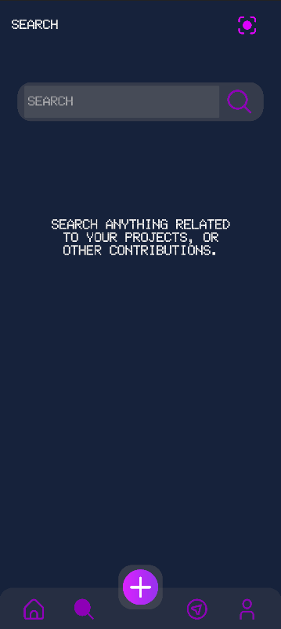
Search page
Search Box
In our search UI, users are empowered with a robust and intuitive tool to explore a vast array of resources related to their projects, contributions, organizations, and more. This feature serves as a gateway to seamless discovery, allowing users to effortlessly navigate through a wealth of information, find relevant projects, identify potential collaborators, and stay informed about the latest developments in the open-source hardware community.

Slide 11

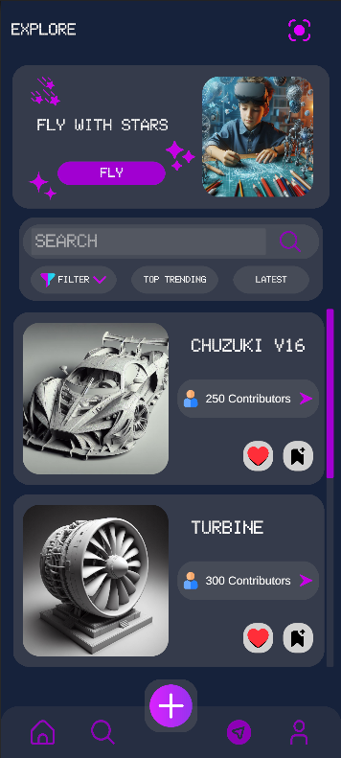
Explore page
Explore
Incorporating an 'Explore' page into our UI, we've curated a dynamic hub where users can immerse themselves in the latest trends and innovations within the realm of collaborative hardware development. This feature serves as a gateway to a multitude of captivating offerings, including trending contributions, insightful discussions, cutting-edge projects, and invaluable resources. By embracing this expansive platform, users can effortlessly stay informed, inspired, and engaged, fostering a vibrant ecosystem of creativity, collaboration, and continuous learning in the ever-evolving landscape of open-source hardware.

Slide 12

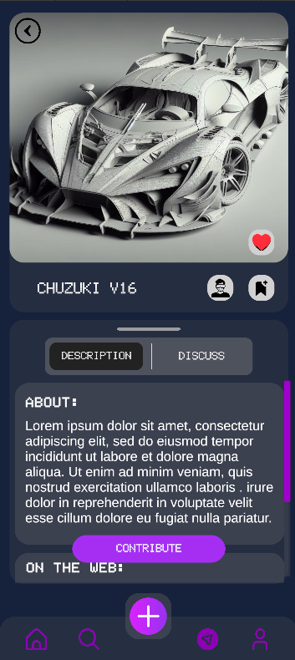
Contribute page
Contribute
Continuing our journey from the 'Explore' page, users encounter a captivating feature: the 'Random Contribute' button, which leads them to a dedicated page showcasing an open-sourced hardware project in all its intricacies. Here, users delve into comprehensive product details, specifications, and instructions on how to contribute.

Slide 13
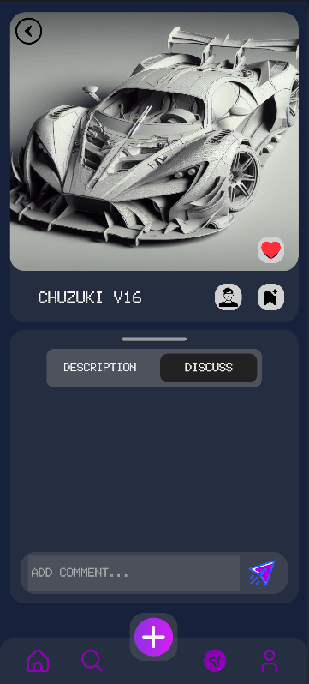
Propose ideas
This page serves as a gateway for users to actively engage with the project, offering insights into the development process and avenues for collaboration. Users are empowered to propose their ideas to the company behind the open-sourced project, fostering a dialogue between creators and contributors.
Upon receiving permission to contribute, users embark on an immersive experience as they transition to a specialized interaction page. Here, users can utilize hand gestures and other intuitive inputs to interact with the product virtually, exploring its functionality and envisioning potential enhancements.
Furthermore, users have the opportunity to upload their own designs and seamlessly integrate them into the product, thereby contributing to its evolution and innovation. With built-in version control mechanisms, users can track changes, collaborate with others, and ensure the integrity of the project's development process.

Slide 14

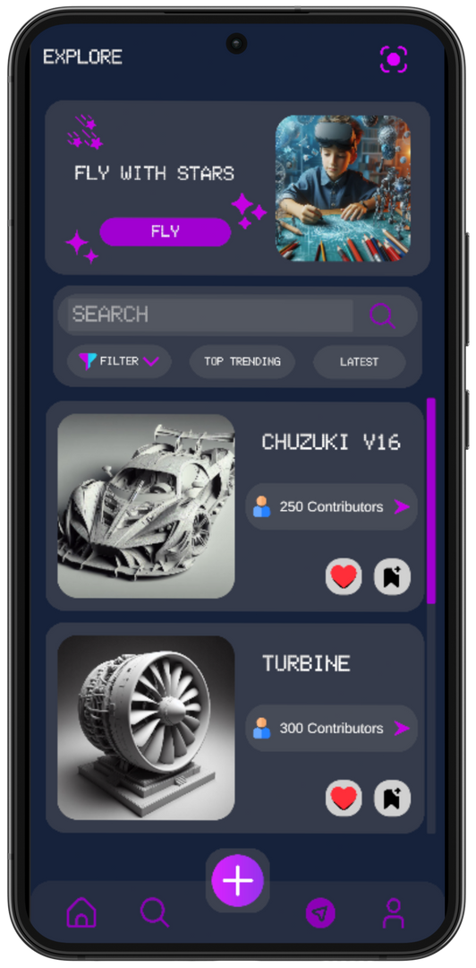
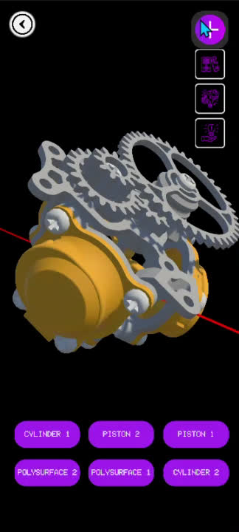
Navigation through pages

Slide 15
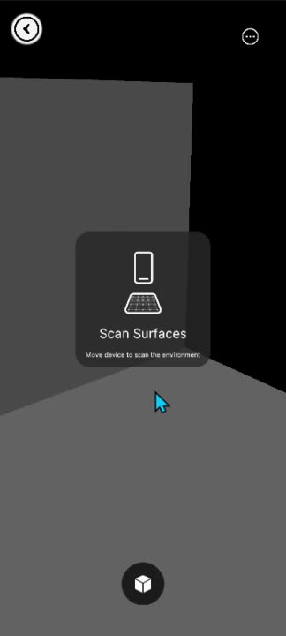
Enhanced Interaction with Depth Scanning and Object Placement in VR
To provide a seamless and immersive experience in our AR/VR hardware collaboration app, we are incorporating advanced depth scanning and object placement capabilities. This feature leverages the device's camera to analyze the surrounding environment, detect depth, and accurately place virtual objects within the real world.

Slide 16

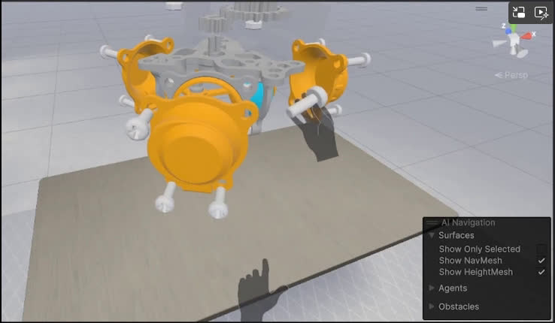
Incorporating Exploded View for Enhanced Collaboration
To enhance the collaborative capabilities of our AR/VR hardware collaboration app, we plan to incorporate an exploded view feature for 3D models. This functionality will allow users to visualize and interact with complex hardware designs by separating components, providing a clearer understanding of each part and its assembly.
Our implementation is inspired by an innovative approach demonstrated by immersive insiders.
How It Benefits Our FUTURA FORGE App:
Improved Understanding: Users can better understand the structure and relationship between different components of a hardware design.
Easier Troubleshooting: By visually isolating parts, users can more easily identify and address issues within the design.
Enhanced Collaboration: Facilitates more effective communication among team members by providing a clear visual representation of the hardware assembly.
Source: immersive insiders

Slide 17
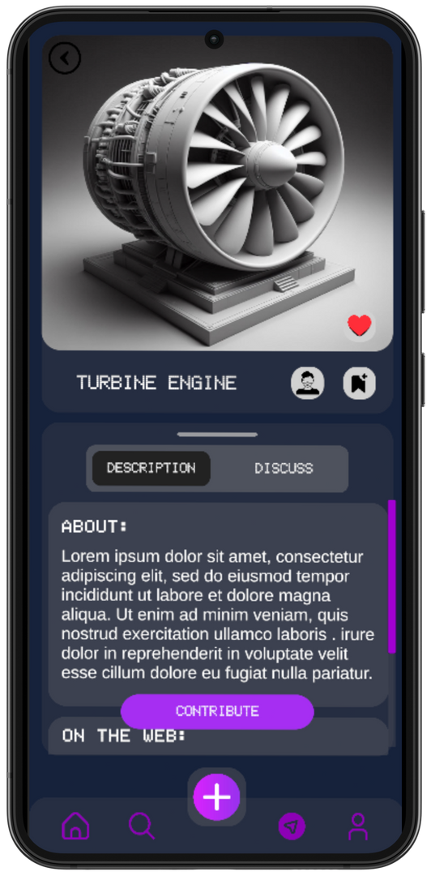
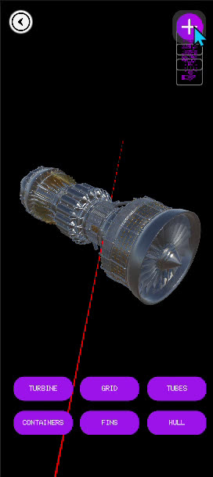
Navigation through pages

Slide 18

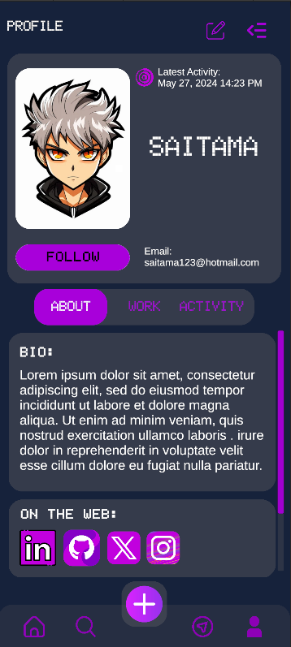
Profile page
Profile
In our UI, the addition of a 'Profile' page marks a significant milestone in our commitment to user-centric design and personalized experiences. This dedicated section offers users a central hub to showcase their contributions, track their progress, and engage with the community on a more personal level.
the 'Profile' page represents our dedication to empowering users, fostering community engagement, and providing a platform for individuals to thrive and make their mark in the world of open-source hardware innovation.

Slide 19

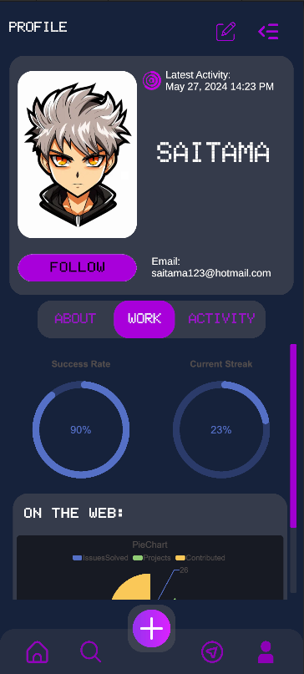
Work page
Profile
At its core, the 'Work' page serves as a digital identity, allowing users to express themselves and share their passion for collaborative hardware development. Here, users can customize their profiles with personal information, showcase their projects, highlight their achievements, and connect with peers who share similar interests. Additionally, the 'Work' page acts as a valuable resource for users to track their progress and growth over time. Through intuitive analytics and visualizations, users can gain insights into their contributions, monitor their impact, and set goals for personal and professional development.

Slide 20
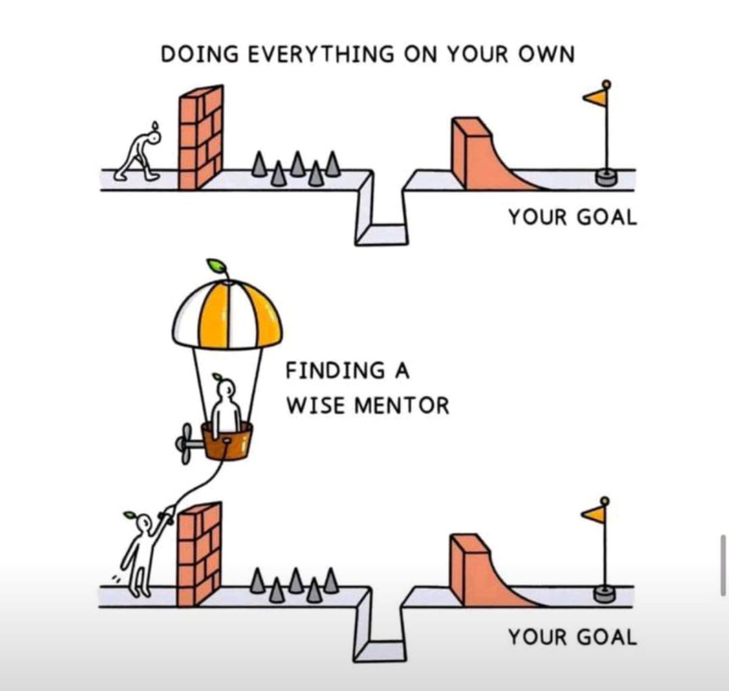
Elevating Collaborative Hardware Innovation
As we embark on this journey to redefine collaborative hardware development, we are seeking mentors who can guide and support us along the way.

Slide 21

Sources
immersive insiders
flaticon.com (for icons)
unity assets (for 3d models and packages)
ReForge Mode - Unity Tutorials (for unity UI Rounded corners)

Slide 22
Our team
where innovation meets imagination, and Ethereal Envisions brings your boldest visions to life through collaborative design excellence.

Slide 23
ETHEREAL ENVISIONS
THANK YOU
Don’t hesitate to contact
Ethereal Envisions

